Slide 1

Muscle Mass Regression Analysis
Exploring the Relationship Between Muscle Mass and Age in Women
By Phuoc Nguyen

Slide 2

Background
Introduction:
A person's muscle mass is expected to decrease with age. To explore this relationship in women, a nutritionist randomly selected 15 women from each 10-year age group, beginning with age 40 and ending with age 79. The results follow on the dashboard; $X$ is age, and $Y$ is a measure of muscle mass. Muscle mass naturally declines with age, leading to reduced strength, mobility, and overall health quality. Understanding this trend can guide interventions to slow or mitigate muscle loss.
Why Is This Important?
Aging populations face increasing risks of sarcopenia (age-related muscle loss). This study provides a foundation for targeted health strategies.
Objective:
Quantify the relationship between age and muscle mass using statistical regression.
Identify trends and insights to inform interventions.

Slide 3
Data overview
Dataset Source: The data is sourced from the textbook Regression Models, Fourth Edition by Michael H. Kutner (Emory University), Christopher J. Nachtsheim (University of Minnesota), and John Neter (University of Georgia). The dataset provides a simple yet comprehensive case study for analyzing physiological changes with age, making it an excellent choice for demonstrating regression models and diagnostics.
Data Description:
Sample: 60 women, aged 40 to 79.
Variables:
𝑌 is the muscle mass (response variable) measured in standardized units. X is age (predictor variable) measured in years.
Why This Dataset?
Two variables allow clear interpretation and visualization.
Includes a wide age range and trends to justify linear and quadratic modeling.
Directly applicable to healthcare and aging research.

Slide 4
Research questions
First-Order Regression: Determine if a simple linear relationship adequately explains the decline in muscle mass with age.
Is the relationship between muscle mass and age linear?
Second-Order Regression: Assess if adding a quadratic term better captures the rate of muscle mass decline as age increases. Evaluate if the model provides reliable and precise predictions for specific ages, such as 48 years.
Does adding a quadratic term improve the model?
Can we confidently predict muscle mass for specific ages (e.g., 48 years)?
Residual Diagnostics: Identify potential issues like non-linearity or other model inadequacies to ensure the model fits the data properly.
Are there patterns in the residuals indicating non-linearity or model inadequacies?
Third-Order Regression: Test if adding a cubic term improves the model significantly or if the simpler quadratic model is sufficient.
Is adding a cubic term justified, or does the quadratic model suffice?

Slide 5
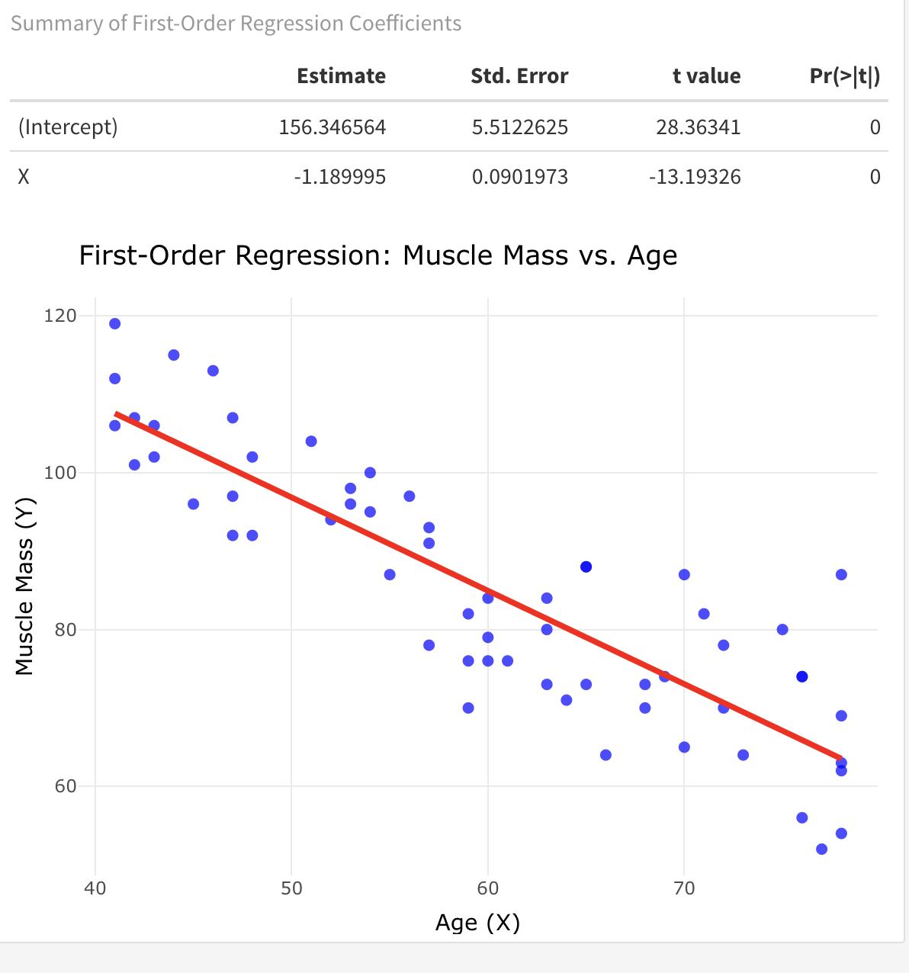

Findings: First-Order Regression
Model Fit:
Linear regression equation: $\overset{ˆ}{Y}=156.35−1.19X$.
$R^{2}=0.75$: 75% of the variability in muscle mass is explained by age.
Visualization:
Scatter plot with fitted linear regression line.
Key Insight:
Muscle mass decreases by approximately 1.19 units per year of age.
A strong initial model but may miss curvature in the data.

Slide 6
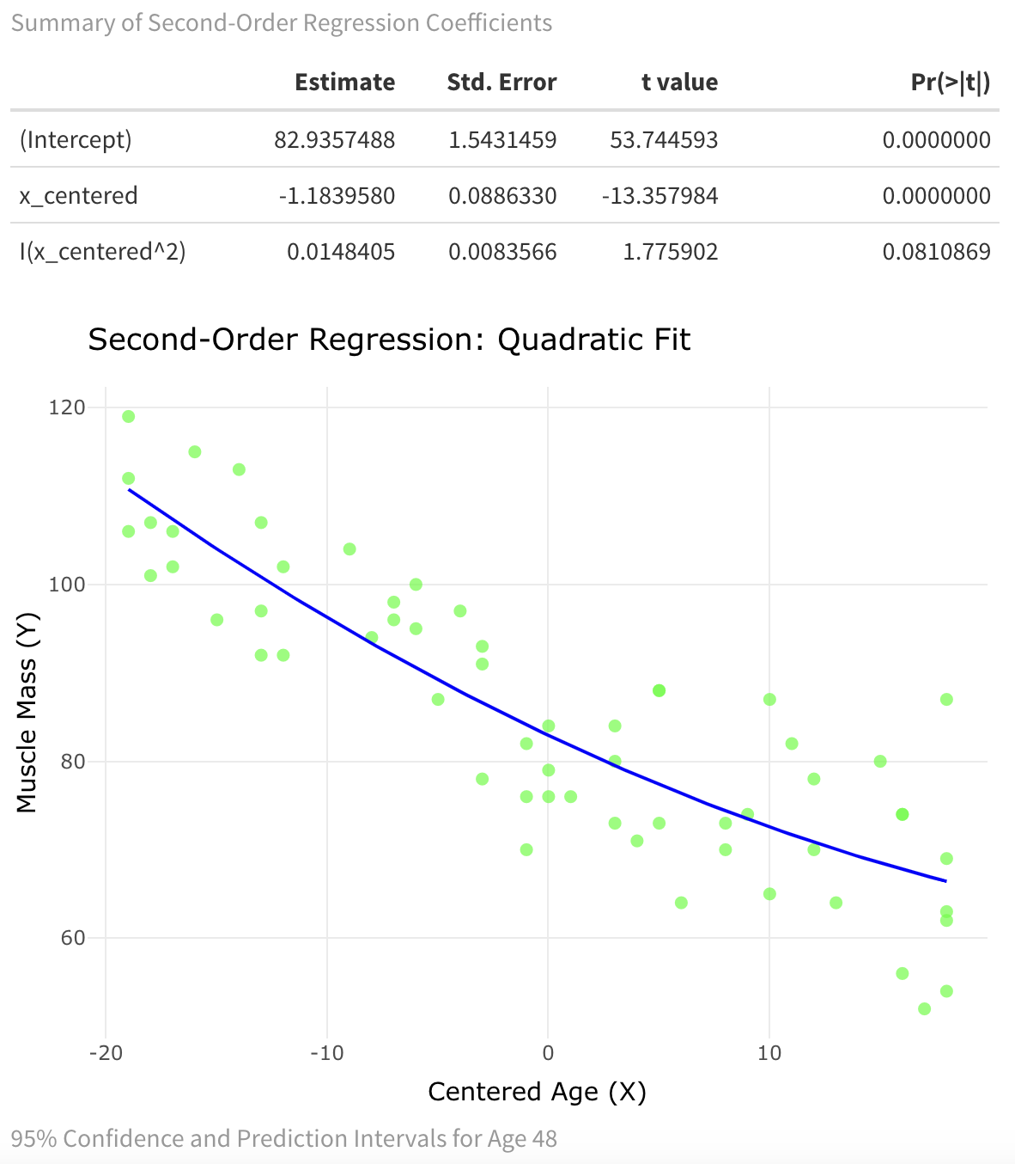

Findings: Second-Order Regression
Model Fit:
Quadratic regression equation: $\overset{ˆ}{Y}=207.35−2.96(X−\overset{‾}{X})+0.015(X−\overset{‾}{X})^{2}$.
$R^{2}=0.76$: Slight improvement over the linear model.
Confidence and Prediction Intervals for Age 48:
Confidence Interval: [96.3, 102.2].
Prediction Interval: [82.9, 115.6].
Visualization:
Scatter plot with a quadratic regression line capturing the curvature.
Key Insight:
The quadratic model reveals a slowing rate of decline at higher ages.
Provides more nuanced predictions and intervals.
Adding a cubic term does not significantly improve the model ($p=0.7$).
The quadratic model provides the best balance between simplicity and fit.
Higher-order terms are unnecessary for this dataset.

Slide 7
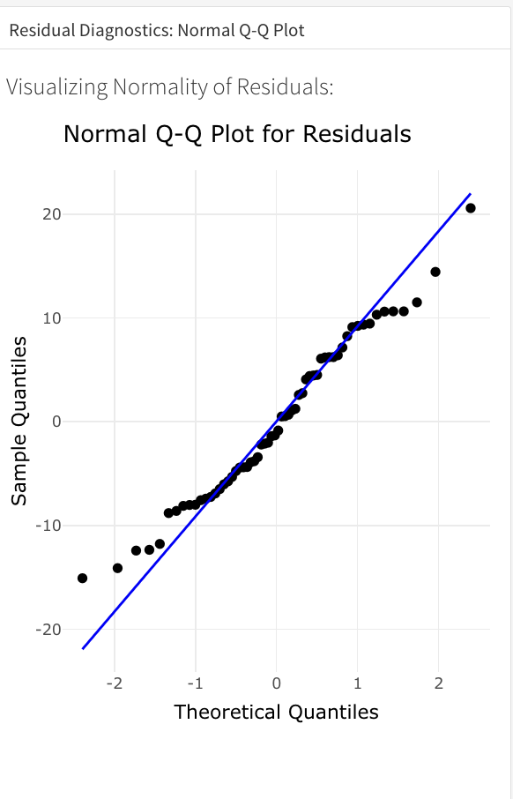

Findings: Residual diagnostic
Diagnostic Visualizations:
Residuals vs. fitted values (see dashboard).
Normal Q-Q plot.
Key Findings:
Residuals are randomly distributed with no apparent patterns.
The Q-Q plot shows minor deviations but approximates normality.
Lack-of-Fit Test:
Fail to reject $H_{0}$: The quadratic model fits the data adequately.
Insight:
The quadratic model captures the relationship without overfitting.

Slide 8
Conclusion
Summary:
Muscle mass predictably declines with age, but the rate slows in older groups.
The quadratic model explains this trend well, balancing accuracy and simplicity.
Predictive capabilities provide actionable insights for healthcare interventions.
Age is a strong predictor of muscle mass.
The quadratic model effectively captures the relationship.
Future Directions:
Include additional predictors like physical activity or diet for a richer model.
Expand the sample to include diverse populations and age groups.
Actionable Insights:
Early interventions (exercise, nutrition) could mitigate muscle loss in midlife.
This study serves as a foundation for further exploration in aging research.

Slide 9

Preferences
Describe what your application does. What to expect from it? Where does the data come from?
The Muscle Mass Regression Analysis dashboard is an interactive tool designed to explore the relationship between muscle mass and age in women. Sourced from the textbook Applied Linear Regression Models, Fourth Edition by Michael H. Kutner, Christopher J. Nachtsheim, and John Neter, the dataset includes 60 women aged 40–79, with muscle mass ($Y$) as the response variable and age ($X$) as the predictor. The application provides interactive data exploration, first-order (linear) and second-order (quadratic) regression models, and predictive tools with confidence and prediction intervals. It also includes diagnostic plots, such as Normal Q-Q plots and Residuals vs. Fitted Values plots, to assess model adequacy and assumptions. Users can dynamically interact with the data and visualizations, enabling clear insights into the trends and variability in muscle mass decline with age while providing actionable predictions.

